Slide 1


NETWORK DESIGN & IMPLEMENTATION
Behpaya Information Technology
Group Members:
Bandara K.M.G.A.P. - PM
Fernando C.J.S. - Wired Engineer
Jayasena W.M.S.A. - Wireless Engineer
Dissanayeka N.K. - Secuirity Specialist
IE2100 - DATA COMMUNICATION WIRELESS NETWORKS

Slide 2


02/12
The Problem & Our Goal
Current Situation:
nearly 50 staff members on two floors
Old mixed devices with no central management
Single 300Mbps internet link
Our Goal:
Build a secure, modern & easy-to-manage network for today and the next 3-5 years

Slide 3
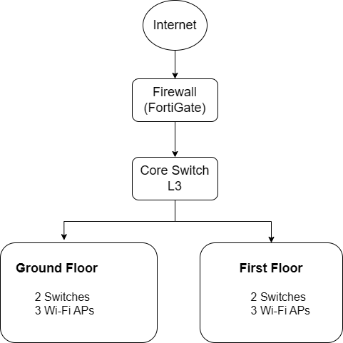
03/12
01
Wired (Gigabit Switches with PoE+)
High-speed wired connections and power over the same cable to devices like phones and access points.
02
Wireless (Wi-Fi 6, 95% coverage at -65 dBm)
Deliver fast, reliable wireless connectivity to 95% of the office with a strong signal strength.
High-Level Solution
03
Security (Firewall + VPN + 802.1X login)
Blocks external threats, a VPN allows secure remote access, and 802.1X login

Slide 4


Logical Layout
04/10
VLAN | Who / What | Purpose
10 | Staff | Normal work
20 | Admin | IT team only
30 | Guest | Internet only (no internal access)
40 | Servers | Network Services
50 | VoIP | Office phones
60 | Printers | Network printers
70 | APs | Wireless management
VLANs :
Seperate Virtual Networks for safety

Slide 5

Ground Floor:
Switch 1 - Open Office, Reception
Switch 2 - Meeting rooms, Printer area
3 Access Points - Lobby, Open Office, Meeting room
05/12
Physical Layout
First Floor:
Switch 1 - Open Office, Admin Office
Switch 2 – Boardroom, Printer area
3 Access Points - Open office, Admin, Boardroom
Central Rack (First Floor)
Firewall
Servers
Core Switch
UPS
Patch Panels

Slide 6

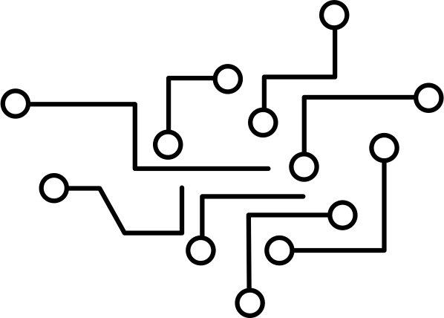
Wired Network
06/12
4 Access Switches (Cisco 2960)
Connects all the desktops and phones.
1 Core switch
Connects everything together
Trunk Links
Carry all VLANS
Port Security
Only approved devices can plug in

Slide 7


Wireless Network
07/12
SSID (Network name) | Who uses it | Security
Behpaya_Corp | Staff | WPA3-Enterprise + username/password
Behpaya_Admin | IT team | Same + extra MFA
Behpaya_Guest | Visitors | Captive portal (accept terms)

Slide 8

08/12
Security
Firewall (FortiGate 80F) - Blocks viruses, bad websites & attacks
VPN with MFA - Remote staff connects safely using phone verification.
802.1x - users must log in before accessing the network.
Rogue AP Detection - Alerts if someone plugs in a fake WiFI

Slide 9

09/12
Syslog Server
Collects all logs
SNMP Alerts
Emails when switch CPU uses more than 80%
Daily Config Backups
Can restore within minutes
Admin Guide
Simple steps to add or remove users
Management & Monitoring

Slide 10

10/12
Budget & Timeline
Item | Cost (LKR)
Firewall + 3yr security | 720,000
Switches (1 core + 4 access) | 930,000
6 Wi-Fi APs + 3yr cloud license | 822,000
Cabling, racks, UPS, installation | 552,000
Total estimated cost =
3,024,000 LKR
1st Week
2nd Week
3rd Week
4th Week
Cabling & mounting
Switches & VLANs
Wi-Fi & Firewall
Testing & Trainig

Slide 11
Test | What we do | Pass mark
Ping | Every device replies | 100%
VLAN isolation | Guest tries to ping Staff | Fails ✓
Wi-Fi signal | Walk around with laptop | ≥ -65 dBm everywhere
Roaming | Video call while walking | No disconnect
Firewall | Try to visit banned site | Blocked
VPN | Connect from outside | Works + MFA
11/12
Testing & Acceptance

Slide 12

12/12
1.Secure
Firewall, VPN, 802.1X, Guest isolation
2.Reliable
Managed switches, Wi-Fi 6, Daily backups
3.Simple
One NMs dashboard, 2 hour training
4.Future - Proof
Scales up to 150 staff without new hardware
WHY Choose Our Proporsal

Slide 13
10/10
Thank you

